Slide 1
Tax invoice, debit note and credit note
Goods and services tax

Slide 2
Basic concepts
Concept of supply – supply of goods and supply of services differentiated
Time and place of supply to be determined separately for goods and services
Supply of goods as goods; goods as services and services as services
Obligation to raise a invoice in case of supply of goods or services at different points in time:
  Regular supply of goods and/or services
  Revised invoice for period between effective date and date of certificate of registration
  Bill of sale
  Voucher for receipt of advance
  Receipt of goods or services from an UR person
  Continuous supply or goods or services
  Cessation of services
  Sent or taken on approval or sale or return basis
  ISD
  Credit or debit note or supplementary invoice
Different types of taxes under Revised Model Law – CGST, SGST, IGST, TDS, TCS and any cess to compensate states (not stated in the Revised Model Law)

Slide 3
Tax invoice (section 28)
Before/at the time of :-
Removal of goods for supply (where supply involves movement of goods)
Delivery of goods/making available to the recipient (in any other case) (Section 7(4))
Supply of taxable goods
Registered taxable person shall issue tax invoice
Supply of taxable services
Before/after provision of service but within 30 days from the date of supply of service. Should provision be read as completion ?
CG/SG may, on recommendation of council, by notification, specify the categories of goods in respect of which tax invoice shall be issued within such time as may be prescribed (45 days for banking and financial institutions including NBFCs)

Slide 4
What is removal of goods?
Dispatch of goods for delivery by the supplier
Collection of goods by the recipient
Invoicing should not be delayed till the goods reach destination
Goods must be in a deliverable state; Mere removal of goods for assembly at customers place does not become removal. Is this statement correct ??
Who can remove?
Supplier
Any person acting on behalf of supplier
Recipient
Any person acting on behalf of recipient

Slide 5
Removal not resulting in supply
Both the legs of Section 28 i.e., sub section (1) and (2), delivery of goods is relevant. Only if goods are for delivery then requirement to issue tax invoice is triggered
Removal should always be for effecting supply. Removal of goods without supply does not require a tax invoice to be raised:
  Removal of goods for supply of services Eg: renting, leasing, hire, right to use goods, works contract, transfer of right in goods without transfer of title, outdoor catering
  Removal of goods for job work and back to principal
  Removal of additional goods added by job worker back to principal
  Removal of goods for no consideration between unrelated persons

Slide 6
Tax invoice (section 28)
A registered taxable person may within 1 month from the date of issuance of certificate of registration issue a revised invoice against invoice already issued during the period starting from the effective date of registration till the date of issuance of certificate
  What happens to taxes already paid by the recipient on RCM basis as purchases from UR person for such period?
A registered taxable person on receipt of advance payment with respect to any supply of goods or services by him issue a receipt voucher or any other document evidencing the payment of advance
  Sub section (2) already requires an invoice to be issued before provision of service, presumably for advances ? Is there a conflict between the sections?
A registered taxable person who is paying tax under RCM shall issue an invoice in respect of goods or services received by him on the date of receipt of goods or services from a person who is not registered under the Act.
  Even for receipt of services the due date is receipt of service and not 30 days from receipt of such service
Any other class of supplier whose goods are notified u/s 8(3) shall issue a tax invoice without tax and mention tax is payable by the recipient under RCM.

Slide 7
Manner of issuance of invoice
Supply of services
Original for recipient of goods
Duplicate for supplier
Supply of goods
Original for recipient of goods
Duplicate for transporter
Triplicate for supplier

Slide 8
Invoice reference number
Invoice reference number can be obtained from the portal by the supplier by uploading a tax invoice on the common portal in Form GST INV-1
IRN so generated shall be valid for a period of 30 days
IRN can be used in lieu of duplicate copy of the invoice by the transporter (no need to carry a separate invoice)
This number is sufficient for clearance at the check-posts
Section 80 require the person in charge of a conveyance carrying goods of value exceeding specified limit to carry documents as may be prescribed for verification and inspection by the proper officer if intercepted

Slide 9
Continuous supply of goods and services (section 2(30) & (31))
Contract
There must be a contract for supply of goods or services
However, for a service contract the contract must be for a period exceeding 3 months
Periodicity
The contract must be for provision or agreement for provision of goods or services on a continuous or on recurrent basis
Invoice / Payment
The contract must envisage for:
1. Regular or periodic invoicing from the supplier in case of goods and
2. Periodic payment obligations in case of service

Slide 10
Invoice for continuous supply of goods and services
Continuous Supply of Goods
Where successive statements are involved
Before/at the time of submission of statement of account
Where successive payments are involved
At the time of receipt of payment
Continuous Supply of Services
before or within 30 days after the recipient is liable to pay for the services (due date of payment ascertainable from the contract)
before or within 30 days after receipt of payment (due date of payment not ascertainable from the contract)
before or within 30 days after completion of an event mentioned in the contract (payment linked to completion of an event)

Slide 11
Scenarios
Cases | Time of issuance of invoice
Supply of beverage thrice a day, but payment made only on Mondays based on the statement submitted for the number of cups supplied during the previous week | Submission of statement
What if Rs.500 is paid as advance in the beginning of every week? Total amount of bill is Rs.2,500 | Receipt of Rs.500 every week and Rs.500 for the balance Totally 5 bills
Construction contract where the amounts will be paid on completion of plinth, 1st floor and 2nd floor | Within 30 days of completion of each stage
Cessation of manpower supply (contracted for 28 days) after 10th day | On the 10th day i.e., time of cessation of services
Liable for registration – 1st April Applied for registration – 15th April Grant of registration – 29th April How to collect tax for supplies made during 1st April to 28th April? | Issue of revised invoice: Separate Invoice: Registered taxable person and Inter-state supplies to unregistered persons (if value more than 250,000/-) Consolidated invoice: All taxable supplies to unregistered person

Slide 12
Special cases – issuance of invoice
Special Cases
Sale on approval or sale or return basis (before it is known to be a supply)
Before or at the time when it is known that supply has taken place
6 months from the date of removal of goods
Cessation of supply before the completion of supply
At the time of cessation and to the extent of work done till cessation. No 30 days period

Slide 13
Importance of invoice
Revised invoice – effective date of reg. till issuance of certificate of registration
Document issued by ISD – supply made earlier – tax invoice.
30 – tax amt. mentioned – tax invoice or other document. Only if supply is made for a consideration
80 – goods exceeds > prescribed limit – carry documents (tax invoice)
Availing ITC – Tax invoice, debit note, suppliers invoice

Slide 14
Contents of an invoice
The name, address and GSTIN of the supplier,
A consecutive serial number containing only alphabets and/or numerals, unique for a financial year,
Date of its issue,
The name, address and GSTIN/Unique ID Number, if registered, of the recipient,
Name and address of the recipient and the address of delivery, along with the name of state and its code - if such recipient is unregistered and where the taxable value of supply is fifty thousand rupees or more;
HSN code of goods or Accounting code of services;
Description of goods/services;
Quantity in case of goods and unit or Unique quantity code thereof;

Slide 15
HSN – Report of Empowered Committee of state finance ministers - October 2015
HSN code (4-digit) for Goods and SAC for Services mandatory initially for all taxpayers with turnover in the preceding financial year above Rs. 5 Crore. Self declaration for first year
For taxpayers with turnover between Rs 1.5 Crores and Rs 5 Crores in the preceding financial year, HSN codes may be specified only at 2-digit chapter level as an optional exercise to start with. From second year, mentioning 2-digit chapter level HSN Code will be mandatory
Any taxpayer, irrespective of his turnover, may use HSN code at 6- digit or 8-digit level if he so desires
To start with, compounding dealers may not be required to specify HSN at 2-digit level also
SAC will be mandatory for those services for which POS are dependent on nature of services to apply the destination principle, irrespective of turnover
HSN Codes at 8-digit level and Accounting Codes for services will be mandatory in case of exports and imports

Slide 16
Contents of an invoice
Total value of goods or services;
Taxable value of goods or services taking into account discount or abatement, if any;
Rate of tax (CGST, SGST, IGST);
Amount of tax charged in respect of taxable goods or services (CGST, SGST, IGST);
Place of supply along with the name of state, in case of a supply in the course of inter-state trade or commerce;
Place of delivery where the same is different from the place of supply;
Whether the tax is payable on reverse charge;
The word “Revised Invoice” or “Supplementary Invoice”, as the case may be, indicated prominently, along with the date and invoice number of original invoice; and
Signature or digital signature of the supplier or his authorised representative.
Board/Commissioner may notify the number of digits of HSN for goods or SAC that a class of taxable person is required to mention. Also class of taxable person not required to mention the same.

Slide 17
Contents of an invoice for export
Invoice should carry an endorsement –
  “Supply meant for export on payment of IGST” or
  “Supply meant for export under bond without payment of IGST”
Invoice should contain:
  Name and address of the recipient
  Address of delivery;
  Name of the country of destination; and
  Number and date of application for removal of goods for export[ARE-1]

Slide 18
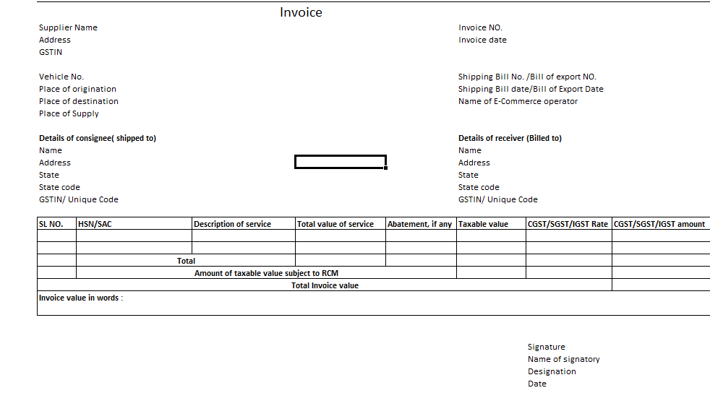
Format

Slide 19
Bill of supply
Should be issued by a registered taxable person:-
  Supplying exempted goods and/or service
  Paying tax under Section 9 – Composition scheme
Period of raising BOS is same as that for tax invoice ??
If supply value is less than Rs.100/- - no need to issue BOS except when the customer wants it.
Consolidated BOS – each day – in respect of all such supplies wherein BOS is not issued

Slide 20
Bill of supply : contents
Name, address and GSTIN of the supplier,
A consecutive alpha numeric serial number,
Dates of its issue,
Name, address and GSTIN/ Unique ID Number, if registered, of the recipient,
HSN code/Accounting code for services,
Description of goods or services,
Value of goods or services taking into account discount or abatement if any, and
Signature or digital signature of the supplier or his authorised representative

Slide 21
Isd – input service distributor
Name, address and GSTIN of the Input service distributor;
A consecutive serial number
Date of its issue;
Name, address and GSTIN of the supplier of service – the credit in respect of which is being distributed - serial number - date of invoice issued by such supplier;
Name address and GSTIN of the recipient to whom the credit is distributed;
Amount of the credit distributed; and
Signature or digital signature of the supplier or his authorised representative.

Slide 22
Goods transportation agency
Gross weight of the consignment,
Name of the consigner and consignee,
Registration number of goods carriage,
Details of goods transported,
Details of place of origin and destination,
GSTIN of the person liable for paying tax whether as consignor, consignee or GTA,
And also other information as prescribed for tax invoice.

Slide 23
Credit notes and debit notes (section 31)
What warrants issue of credit notes?
Taxable value is more than actual taxable value
More tax has been charged
Supply returns
Deficient supply of services made by you
When can debit notes be issued?
When the taxable value is less than actual taxable value
When the tax charged is less than actual tax payable
Who is supposed to issue credit note or debit note?
Only a supplier is allowed to issue a credit or debit note

Slide 24
Time limit for issuance of credit or debit note
Time limit for issuance of credit note: Earliest of
  Filing return for the month of September of the next year or
  Filing of relevant annual return
  As a consequence of the above time limit, all the price revisions has to happen before the earliest of the above two dates if such price revisions are retrospective in nature to enable reduction in tax liability.
Time limit for issuance of debit note: No time limit – However ITC to the recipient is subject to above time limit
A debit note includes a supplementary invoice.

Slide 25
Consequences of issue of credit or debit notes
Tax liability or Input tax credit
Credit note
Incidence of Tax and interest should not have been passed on to the recipient, if yes then the tax liability of the supplier shall be reduced
Otherwise, tax liability of the supplier shall be reduced only to the extent of ITC reversal by recipient
Debit note
Once accepted by the recipient, both the tax liability and ITC shall be increased to the extent mentioned in the debit note

Slide 26
Contents of supplementary invoice or credit or debit notes
Name, address, GSTIN of the supplier
Nature (debit or credit) of the Document
Serial Number having only alphabets/numerals
Date of Issue
Name, and address of the recipient
GSTIN/UID of the recipient, if registered
Name and address of the recipient and address of delivery, along with the name of state and its code, if such recipient is unregistered
Serial number and date of the corresponding tax invoice/bill of supply
Taxable value of goods or services, rate of tax and the amount of tax credited/debited to the recipient
Signature/Digital Signature of the Suppler or his authorised representative

Slide 27
Tax invoice in Special cases
If ISD is an office of a Banking Company or a Financial Institution including NBFC; the tax invoice is deemed to include any document which may or may not be serially numbered.
In case of above companies for taxable supply of services, shall issue a tax invoice or any other document in lieu thereof, by whatever name called, whether or not serially numbered, and whether or not containing the address of the recipient of taxable service but containing other information as prescribed under rule 1.
In case of passenger transportation service, a tax invoice shall include a ‘ticket’ in any form. The requirement of having the address of the recipient of taxable service on the tax invoice is waived.

Slide 28

Thank You
For any Clarification, Please Contact
Indirect Taxes Committee of ICAI
Email: idtc@icai.in, Website: www.idtc.icai.org

